Slide 1

Open Compute +48V Busbar Discussion
Engineered
Power Solutions

Slide 2
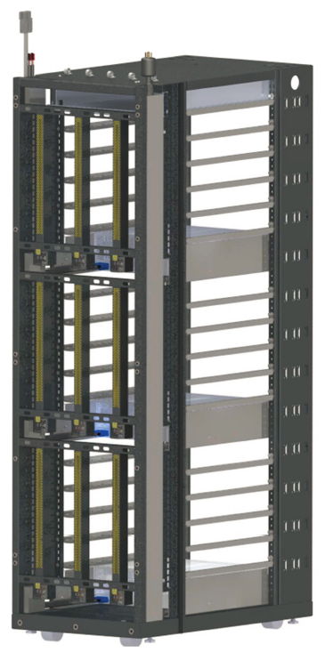
Opportunities with Open Rack
There are a few areas within the Open Rack 2.0 standard that remain undefined. In terms of the mechanical requirement of the busbar assembly, there is a gap where rack mount details are missing. This means that ever rack mounts to every busbar differently.
It is difficult to design a busbar that will work in many applications for OCP. This is compounded when working towards an “OCP Accepted” certification. The reason is that to be “Accepted” the certification is granted per part number and not general application
This is very difficult to achieve at a busbar level due to many variables that tend to be customer specific:
Power Requirements
Height (OU, OUI, etc.)
Location of Power Supplies
Mechanism/Locations for attaching the Power Supplies
Mounting Criteria for Busbar
Each Power Section (3) can have 1, 2 or 3 busbars

Slide 3
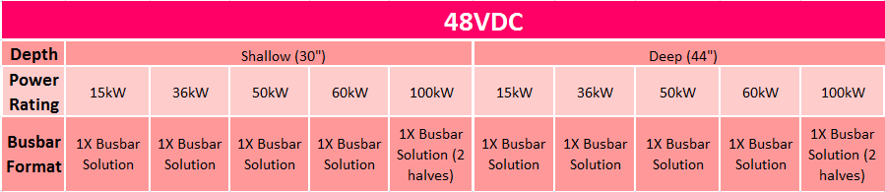
OCP Specification
To expand upon Rittal’s Options: Amphernol is developing higher power busbars
50 kW
60 kW
100 kW
Each of these will add additional SKU Levels:

Slide 4
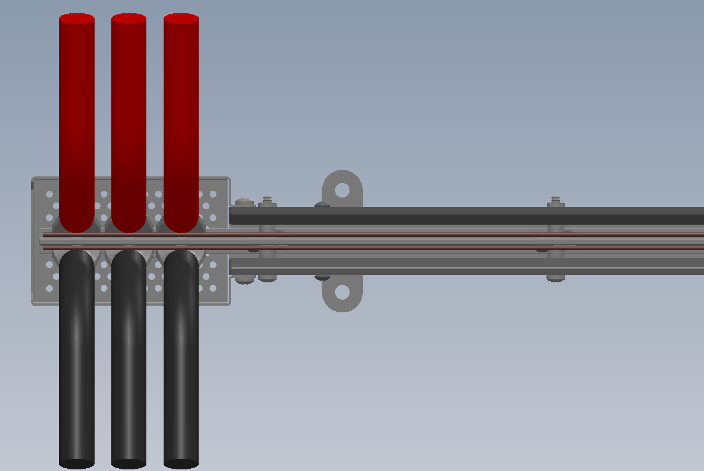
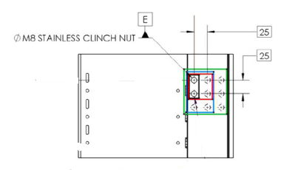
Management of Power Supply Connections
36 kW Busbar would require (3) 4/0 wires
for each potential
PowerLug or
Busbars from
The Power Supply
Protective Cage
Busbars
May need to change
these dimensions
and/or add studs?
Blind Mate Guides
Future question is with higher kW requirements, will 3 posts be sufficient?
Will the spacing need to change to accommodate larger wire gage?

Slide 5
Example of OCP 48V Busbar SKU Matrix
P/N: BBOCP 48 AA BBB PSCCDD EE
Rack Manufacturer
CW = Chatsworth
DT = Delta
EN = Emerson
FX = Flex
RC = Rack Space
RS = Rack Solutions
RT = Rittal
TL = Telect
BusBar OCP
48 = 48V
Watts
15 = 15kW
36 = 36kW
50 = 50kW
Power Supply
Location
CC = OU(I) of first PS
DD = OU(I) of 2nd PS
Rack OU or OUI
XXU= “#”OU
XXI = “#”OUI

Slide 6
Power Zones
Not all Power Ratings are the Same!
Regarding the Topic of Power rating for an entire rack. A 36kW rack for example can be configured with a Single Power Zone, a Split Single (Dual), or (3) 12kW Power Zones.
It is our suggestion that the number of Power Zone(s) should be considered when rating the busbar in context to the rack. A single 36kW power zone bubar will have more copper mass than a Split Single Zone 18kW busbar.
PS
PS
Busbar
Busbar
PS
PS
Single Power Zone
Dual Power Zone

Slide 7
Power Supply Location
Another challenge is the location of the Power Supply(ies). This becomes a particular challenge with the full length busbars (~42 OU).
As a power solutions provider, the preference would be a central location to minimize the copper usage or increase the power availability
For example, the design of a 36 kW busbar with the power supplies centrally located will minimize the copper needed to support this power level (half the power for each busbar leg) vs. locating the Power Supplies either top or bottom which will require the support the full power (~950A at minimum voltage)
PS
Larger Busbar
Busbar
PS
PS Centrally Located
PS Top Located

Slide 8
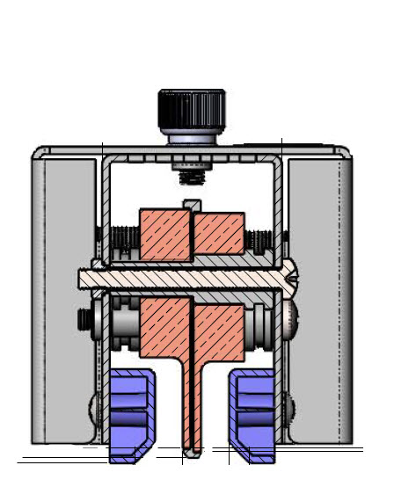
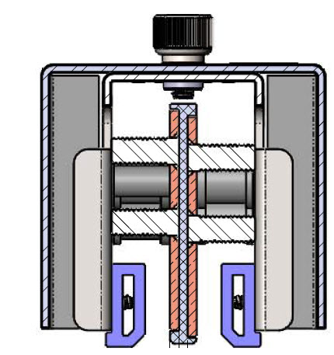
Copper Sizing Calculation
Busbar current ratings can vary from vendor to vendor. Should we reference in section 3.2 for the 48V OCP spec a variable for determining power rating based on cross section area of copper. A 30 degree C T Rise.
In the development of Busbars we use a very easy to remember formula of:
5A / mm²
This has been supported by Simulation and Load testing by groups within Amphenol (AIPC and AFCI).

Slide 9
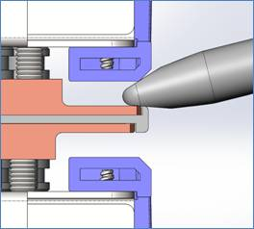
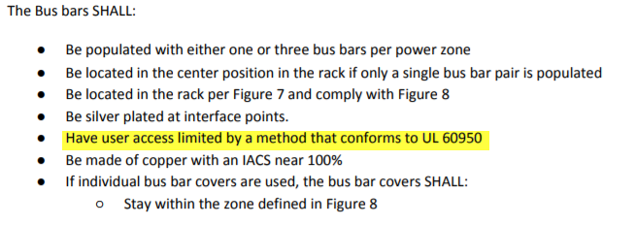
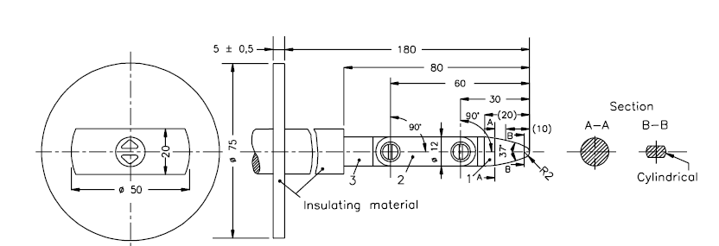
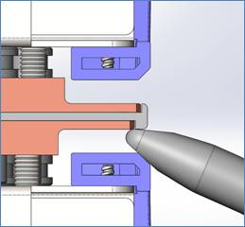
Touch Proof Requirement – Open Rack 2.0 Section 2.5
IEC60950 requires a finger probe test as shown in the below images.

Slide 10

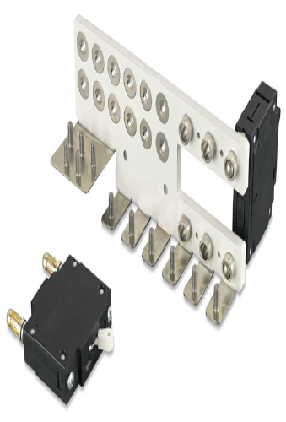
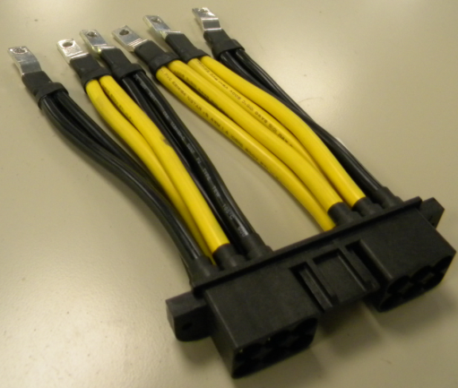
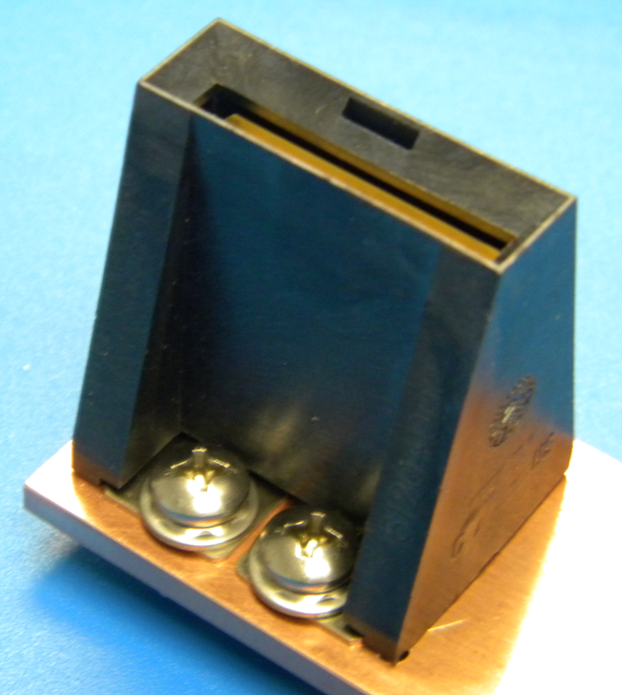
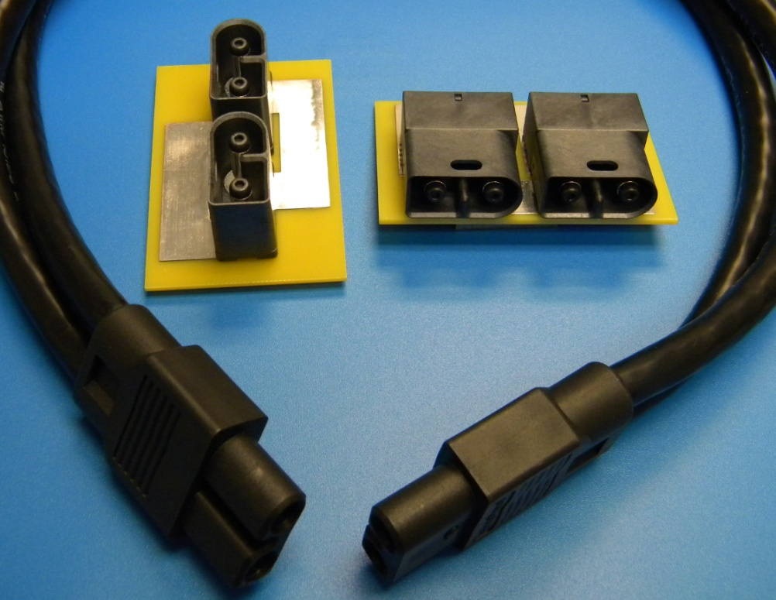
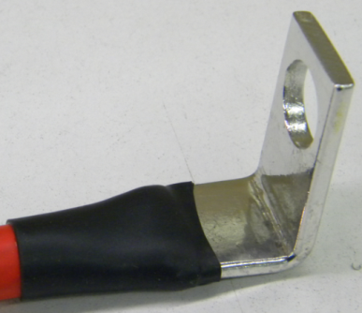
THANK YOU!
Busbars
Power
Assemblies
Connectors
Cable Assemblies
PowerLugs

